Slide 1



SCC/MLA 2025
USING LABELS
TO MAXIMIZE RAYYAN DURING SCOPING REVIEWS
Work Smarter, Not Harder
Joanna Russell Bliss
Notes:
Welcome to my presentation!

Slide 2


I’M JOANNA!
I am a health sciences librarian
and the manager at the Dallas Campus
for Texas Woman’s University.
I work with several subject areas, but my occupational therapy partners are particularly interested in scoping reviews.
Notes:
I've been working as a health sciences librarian for more than three years now. At TWU, our OT faculty and PhD students often work on scoping reviews.

Slide 3


RECENT PUBLICATIONS
Gray, R.L., Cooper Hay, C., Yates, J.M., & Bliss, J.R. (2025). Power mobility driving assessments used in research with adults in residential care: A scoping review. Assistive Technology, 1–10. https://doi.org/10.1080/10400435.2025.2487701
Hintz, L.A., Maas, C., Bliss, J.R., & Pizarro, E. (2024). School-based occupational therapy and multitiered systems of support in the United States: A scoping review. Journal of Occupational Therapy, Schools, & Early Intervention, 17(3), 605-623. https://doi.org/10.1080/19411243.2024.2315577
Notes:
Since I began working on these in 2022, I've been an author on 2 published scoping reviews, and I'm currently a part of two teams that are in the data extraction/ manuscript writing phase and a third that was just submitted for publication.
All of this is to say that I've been learning as I work on each one, building my process to make it easier for everyone on the team.

Slide 4

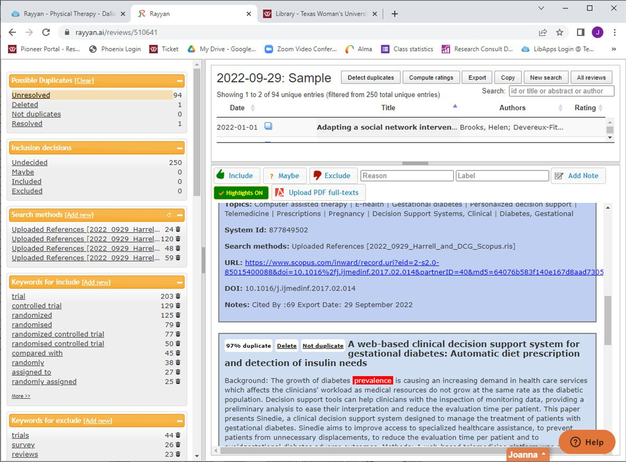

WHAT IS
RAYYAN?
Software that can help to organize and manage systematic and scoping reviews
Old version, discontinued in 2024
Notes:
So, what is Rayyan? It's one of several online managers for systematic and scoping reviews. The main feature most focus on is that there is a free version with most of the benefits of the paid accounts.
If you haven't tried it in a while, this is what it used to look like...

Slide 5
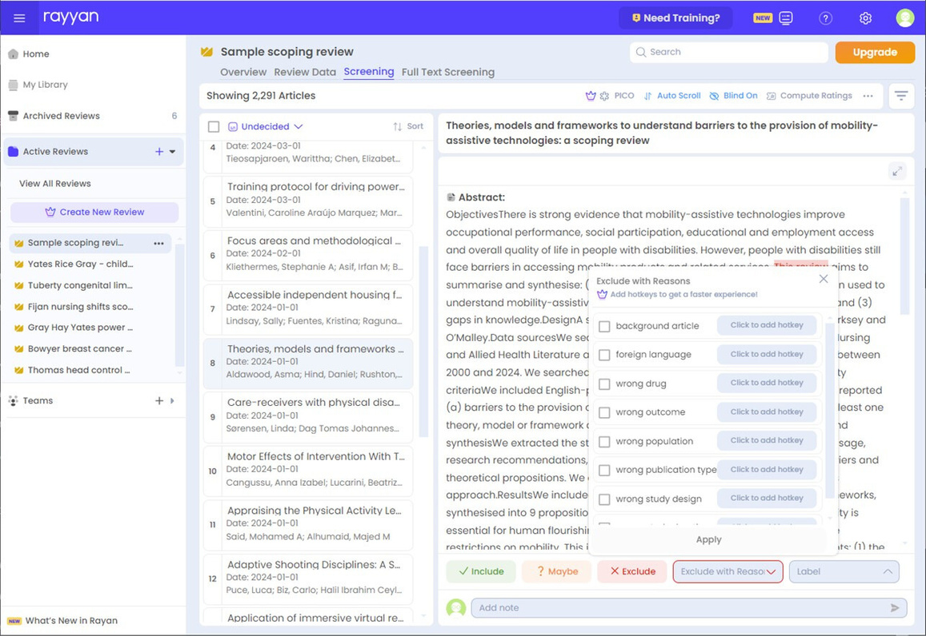
WHAT IS
RAYYAN?
Software that can help to organize and manage systematic and scoping reviews
New version, launched as beta
in 2023
Notes:
But the newer version has a better and more modern interface, along with several new features...

Slide 6

BENEFITS OF
THE NEW VERSION
AI-enhanced deduplication
Full text screening
Still free!
Notes:
Along with the cleaner user experience, Rayyan has been adding more features in their latest version. Deduping can be sped up with AI tools, controlled by the user. They've added a full-text screening tab that includes PDF uploads, simplifying the process. There's even a new data extraction tool that our teams are currently testing. And it's still free!

Slide 7
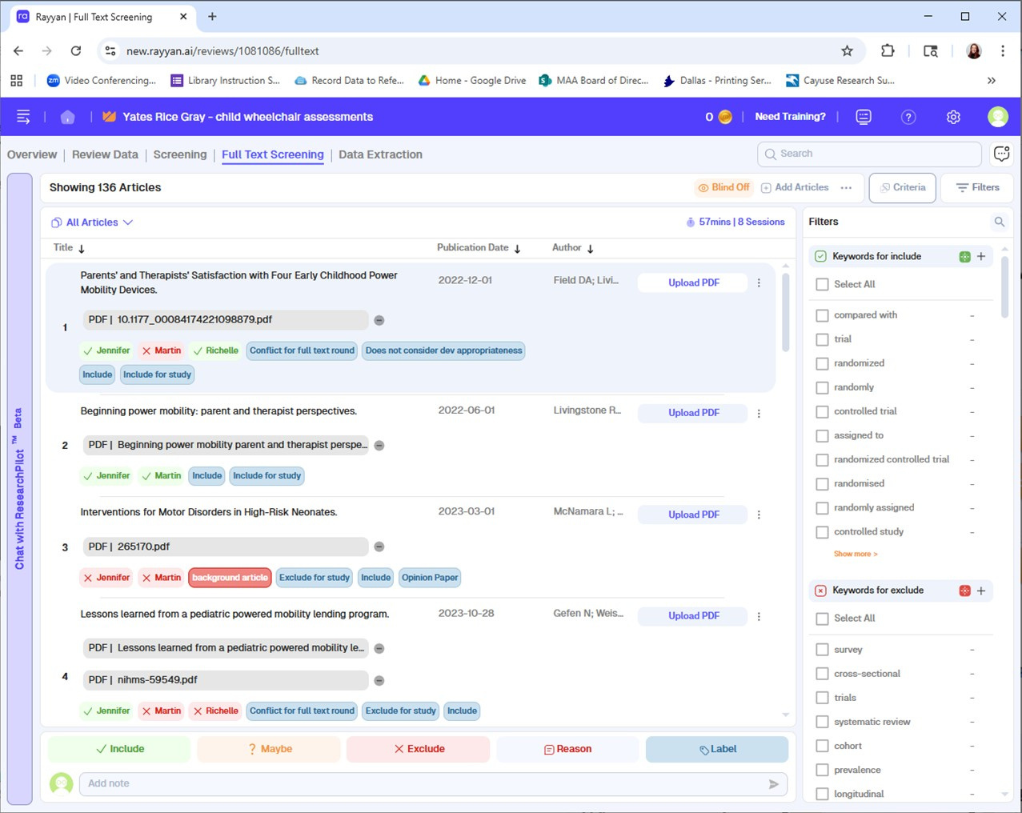

HOW TO
USE LABELS
IN RAYYAN
Notes:
The most basic element used in Rayyan is the anonymous review, allowing each reviewer to vote on inclusion or exclusion without the other authors knowing the team's votes until the blind is removed.
Because Rayyan allows for Include, Exclude and Maybe, I began using labels to track what is included and excluded during each round of study.
You can see that the button to add a Label is right next to the buttons to Include, Exclude or say "Maybe" for each title.

Slide 8
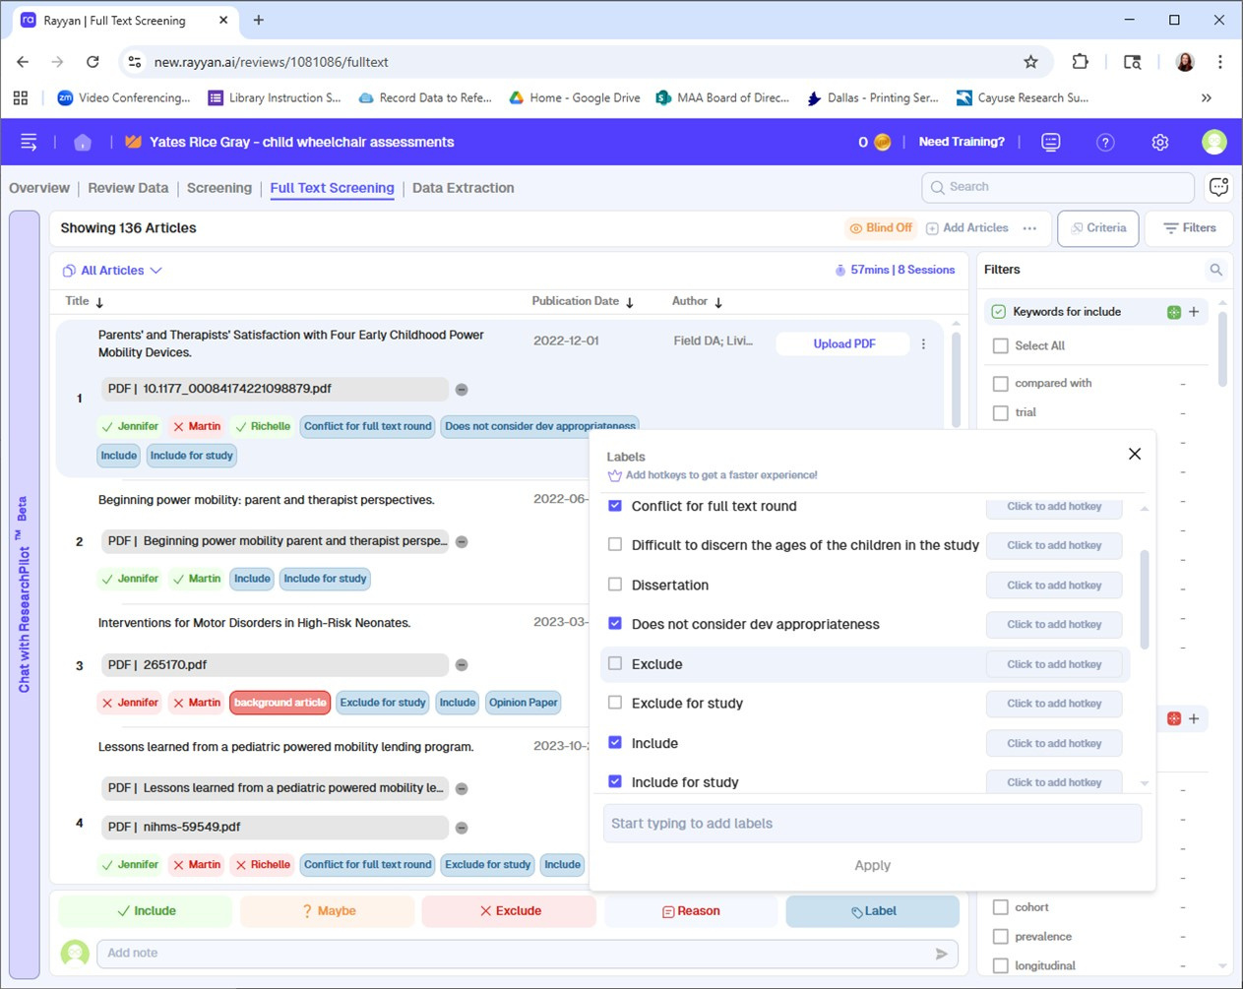

HOW TO
USE LABELS
IN RAYYAN
Notes:
The labels can be customized to whatever you'd want to track -- not just whether a title is included or excluded, but also WHY.

Slide 9

HOW TO
USE LABELS
IN RAYYAN
Notes:
You can see here that the authors have added their reasons for exclusion to the list of labels, allowing them to track these throughout the process. For example, the 3rd title was excluded because it was an opinion paper.

Slide 10
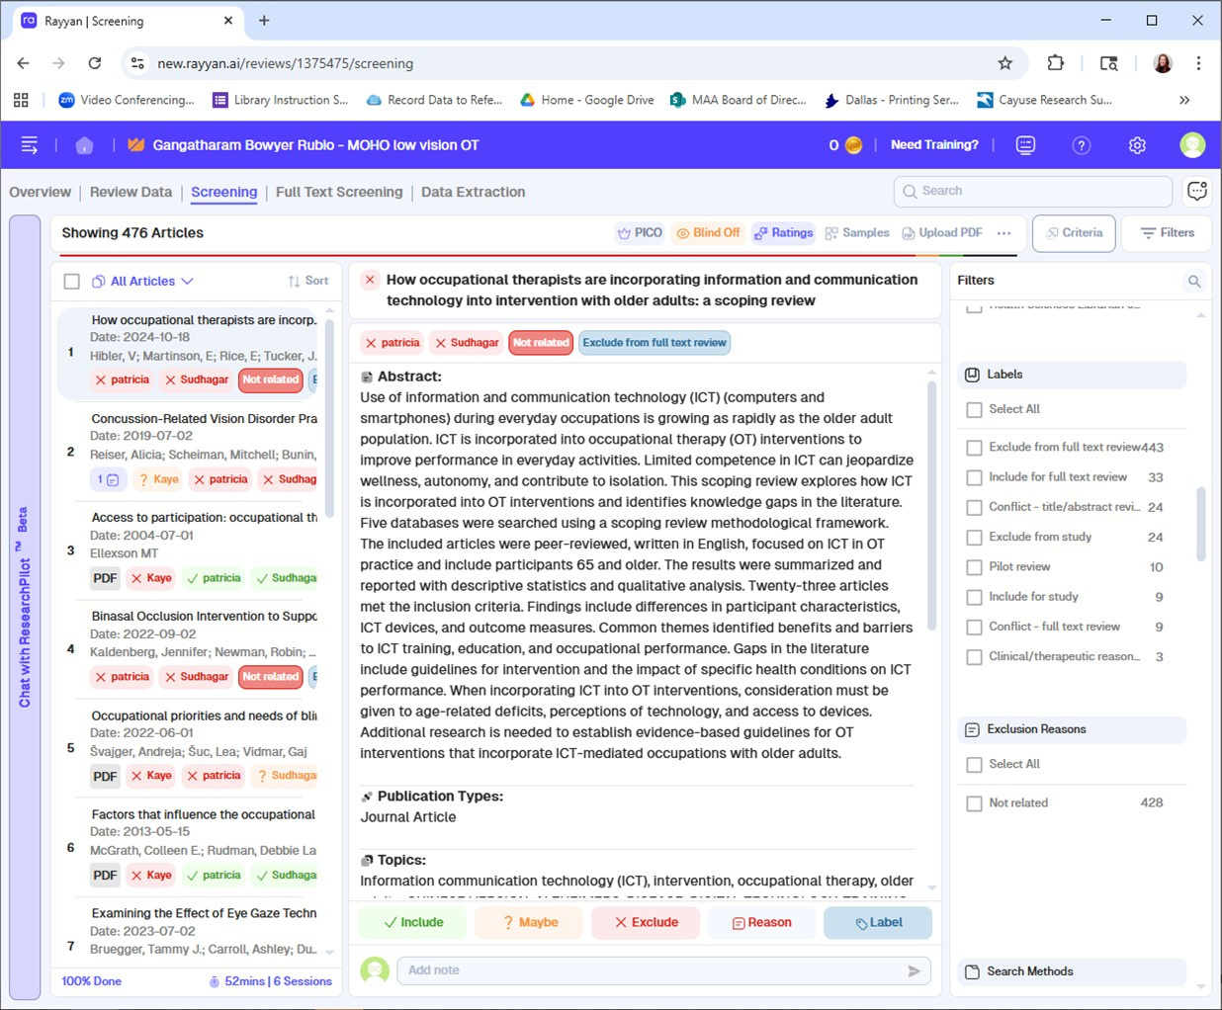

WHY YOU SHOULD USE LABELS IN RAYYAN
  Labels make it easier to track and export information for titles in conflict or inclusion/exclusion (if team uses “Maybe” during voting, titles can be lost)
Notes:
There are several ways that using labels in Rayyan can help you throughout the scoping review process.
* I learned about Maybe with one of my first reviews. It may be helpful to your team to mark something Maybe in order to imply that it may not fit the parameters, but it can throw off your math for rounds of exclusion. Using labels to track what is included and excluded in each round can make sure you know the math.
I know exactly how many were excluded from and included for full text review through the labels. Note that I'm very careful with the wording for the labels so that I can distinguish between what's excluded during the title/abstract round and what's excluded during the full text round.

Slide 11
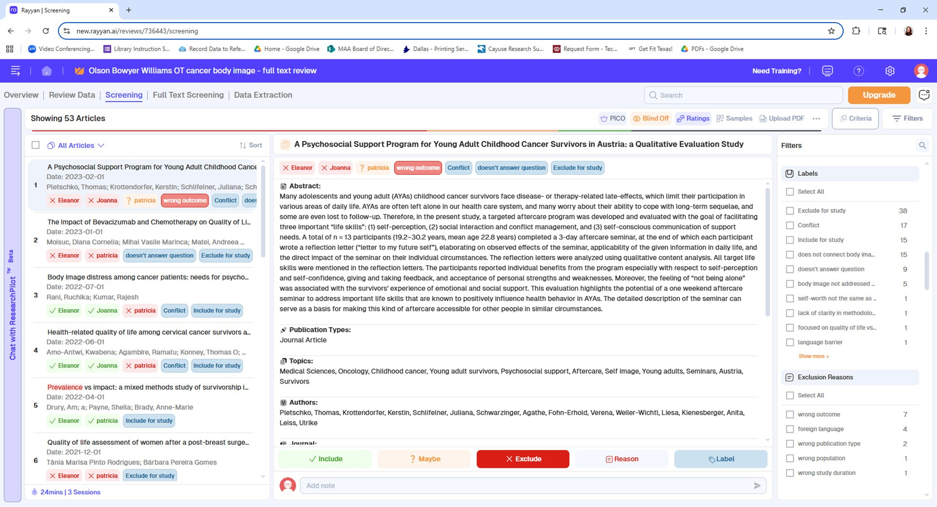

WHY YOU SHOULD USE LABELS IN RAYYAN
  Labels make it easier to track information for PRISMA, including going back to track reasons for exclusion during full-text review
Notes:
* Tracking information is exceptionally important as the rounds of exclusion for a scoping review can be months or years before a manuscript is written. Because one of my teams tracked their reasons for exclusion from the very beginning, I was able to put together their PRISMA flow chart and write the reasons excluded without having to ask the team for more information. It had been documented more than a year before we began working on the manuscript.
Rayyan also offers the option to enter reasons for exclusion, which you can see below the list of Labels. This can also be filtered, but cannot be exported, which is why I recommend using the labels.

Slide 12
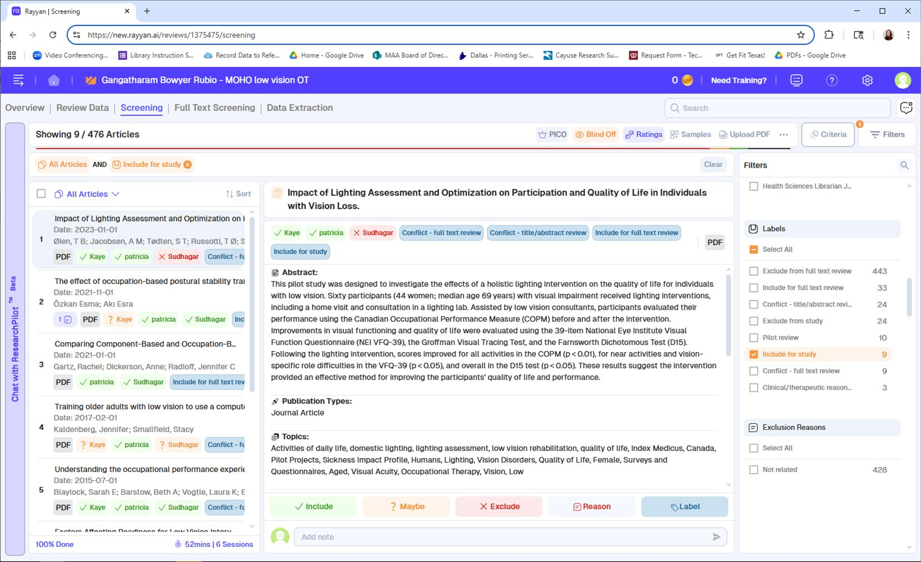
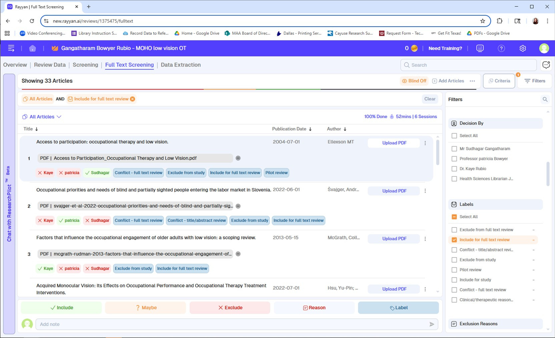

WHY YOU SHOULD USE LABELS IN RAYYAN
  Labels make it easier to track and export titles included in the study
Notes:
* Speaking of exporting, because labels can be used to export information, they make team updates a snap. Here are the titles we've included in the study. Here are the titles in conflict during your full text round of review. You don't need to hunt and peck for the information; it's right there and easily accessible.
Here, I've filtered my results for the label "include for study". I can see the total for that label in both the filters column under labels on the right of the screen, and in the header toward the top left of the screen.

Slide 13

WHY YOU SHOULD USE LABELS IN RAYYAN
  Labels make it easier to track and export titles included in the study
Notes:
Exporting isn't completely intuitive... Toward the upper right, there are three dots. If you click on them...

Slide 14
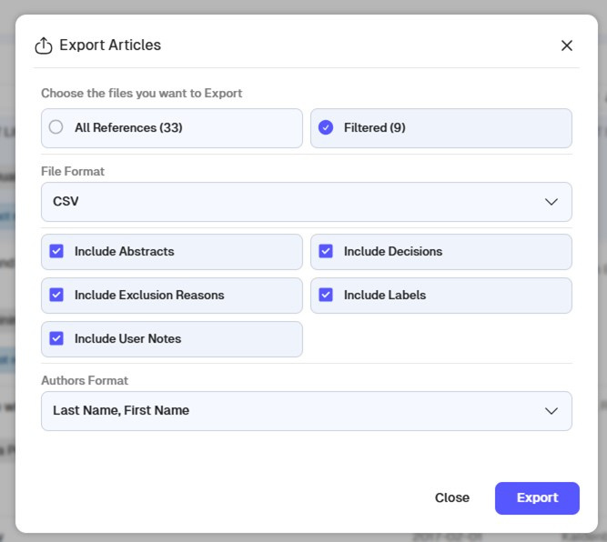
WHY YOU SHOULD USE LABELS IN RAYYAN
  Labels make it easier to track and export titles included in the study
Notes:
You'll get the option to export either all of the titles in that tab, or your filtered results. Any label can be filtered in order to export; it's the biggest reason I use them for my reviews.

Slide 15
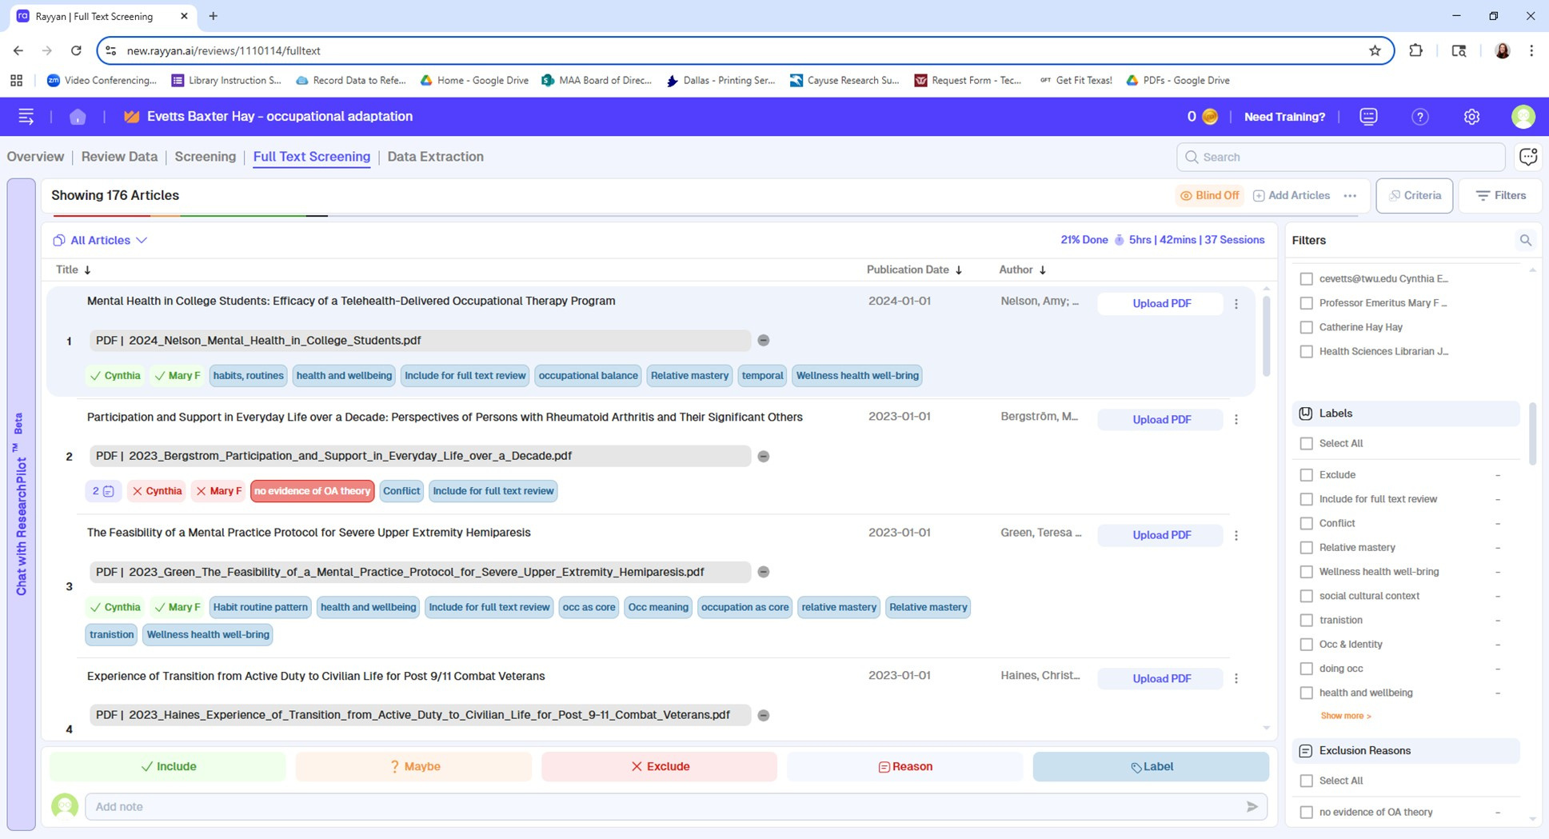
WHY YOU SHOULD USE LABELS IN RAYYAN
  Labels make it easier to track concepts for data extraction or the manuscript
Notes:
* And, finally, in that vein, I have a team using labels to track concepts for their data extraction. They are looking for articles that relate to the Model of Human Occupations, an OT theory. You can see that they've been adding labels for themes like health and wellbeing to help with when they're ready for data extraction.

Slide 16

IN SUMMARY
Labels can be used to...
  Keep track of how many titles are reviewed, included and excluded in each round of review
  Track information for PRISMA
  Export information for the review team
  Label themes for data extraction
Notes:
To summarize, there are several ways that using labels can simplify your process when using Rayyan for a scoping review.

Slide 17


REMEMBER
Working on scoping reviews is a process, and so is getting to know the software
you use to manage that process.
Using labels is one way to simplify your process; I’d love to hear how you’ve used their tools in your own reviews.
Notes:
Doing a scoping review is a process, a long one. It takes time to develop your own preferences, and you may find new ways to simplify how you do them.
If you've got a tip to share, I'd love to hear it!

Slide 18

THANK YOU!
Joanna Russell Bliss
Texas Woman’s University
jbliss3@twu.edu
Notes:
Questions?

