Slide 1
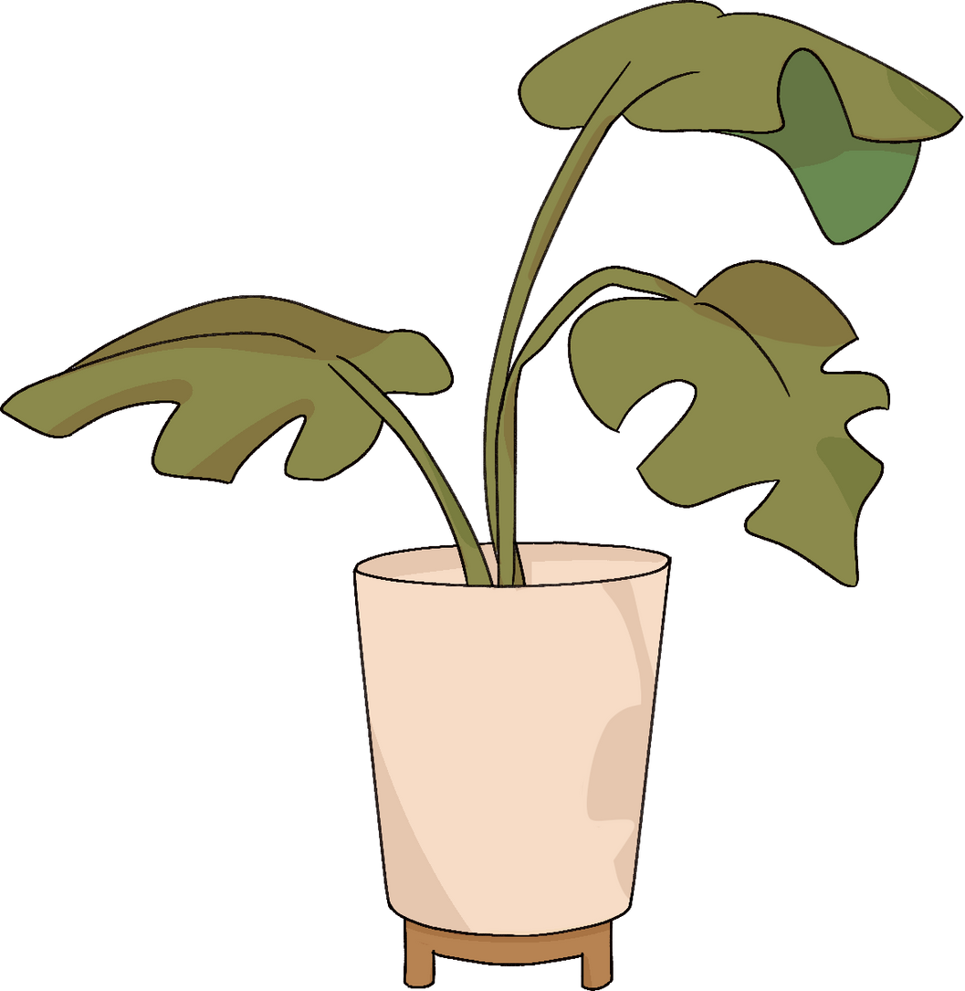

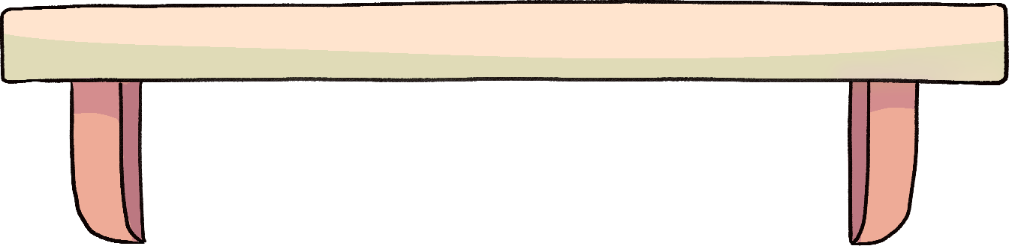
SCC/MLA
OCTOBER 2024
OUTREACH PROMOTING HEALTH LITERACY
A Forum Discussing Collaborative Health Education Promotional Opportunities
Notes:
Joanna
Hi! My name is Joanna Russell Bliss. Welcome to our 2024 round table on outreach promoting health literacy.

Slide 2


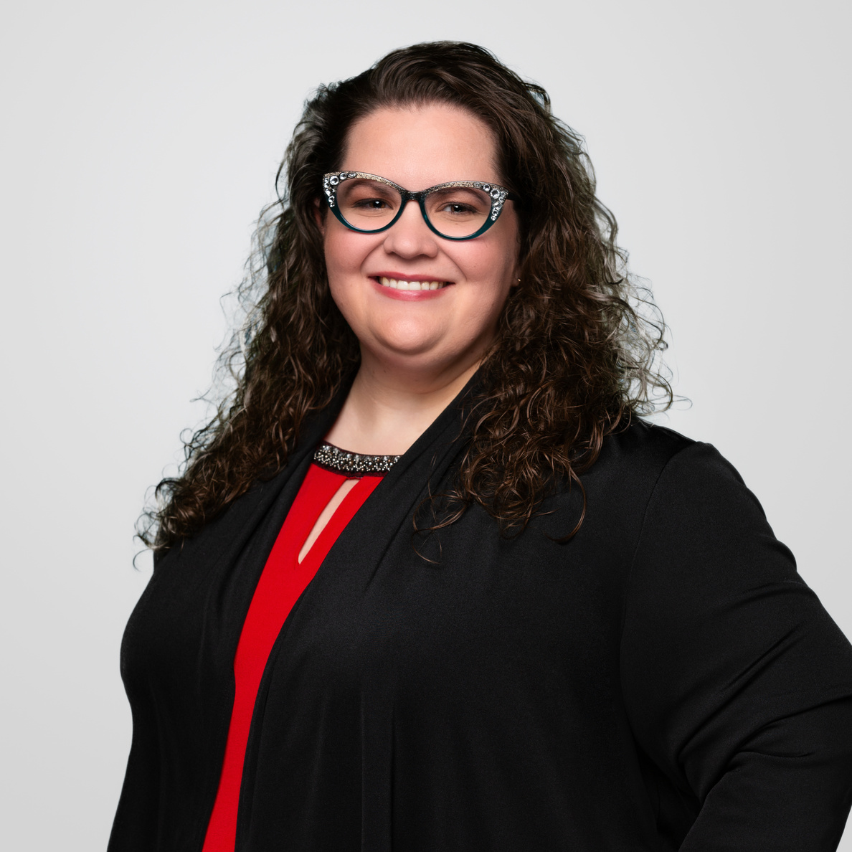

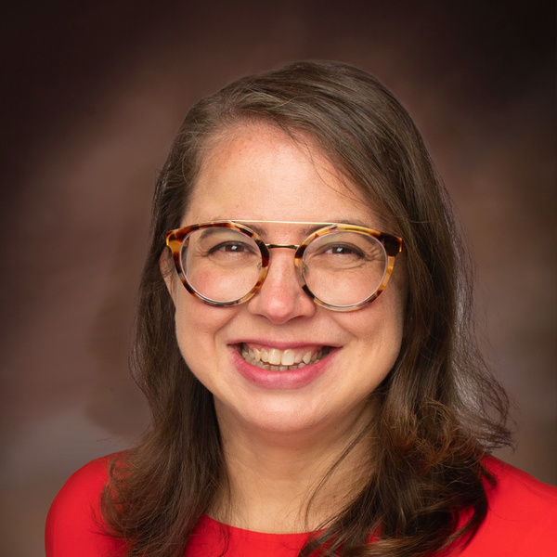
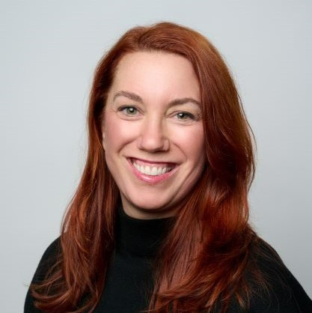

PRESENTERS
ESTHER GARCIA
ALEXIA RIGGS
JOANNA RUSSELL BLISS
Notes:
Joanna
Alex, Esther and I have been working together over the last several months on a variety of projects, and we hope this round table gives you a chance to meet and collaborate with new colleagues at other institutions.

Slide 3




PRESENTATION OUTLINE
INTRODUCTIONS
ROUND TABLE ACTIVITY
LITERATURE ROUND-UP
QUESTIONS & FEEDBACK
Notes:
Joanna
A brief outline of our presentation: We'll introduce ourselves and our current projects, briefly discuss the literature that underscores the importance of health literacy and collaboration, and then have an activity that jumpstarts what you can do at your own institution. We'll wrap it up with questions and ask for your feedback.

Slide 4


INTRODUCTIONS
WHO WE ARE
& WHAT WE DO
Notes:
Joanna
First, who are we? Why should we be talking about this? Alex?

Slide 5




ALEXIA RIGGS, ED.D
Alex is the Senior Director,
Library and Information Services, at
Alice L. Walton School of Medicine
She is currently building a
new medical library. Her focus
is community health
literacy engagement.
Notes:
Alex

Slide 6



ESTHER GARCIA
Esther is a health science librarian at Texas Woman’s University.
Her research interests are in bibliotherapy and health promotion.
Notes:
Esther

Slide 7


JOANNA RUSSELL BLISS
Joanna is a health sciences librarian and the Manager of the Dallas Campus Library for Texas Woman’s University in Dallas, Texas.
Current project: Building a lending library with the Mike A. Myers Stroke Center at TWU Dallas
Notes:
Joanna
I am also a health sciences librarian and the manager at TWU's Dallas campus. I am currently collaborating with our stroke center, developing a lending library for their patients and caregivers. I have also started building a relationship with one of our local public libraries.

Slide 8

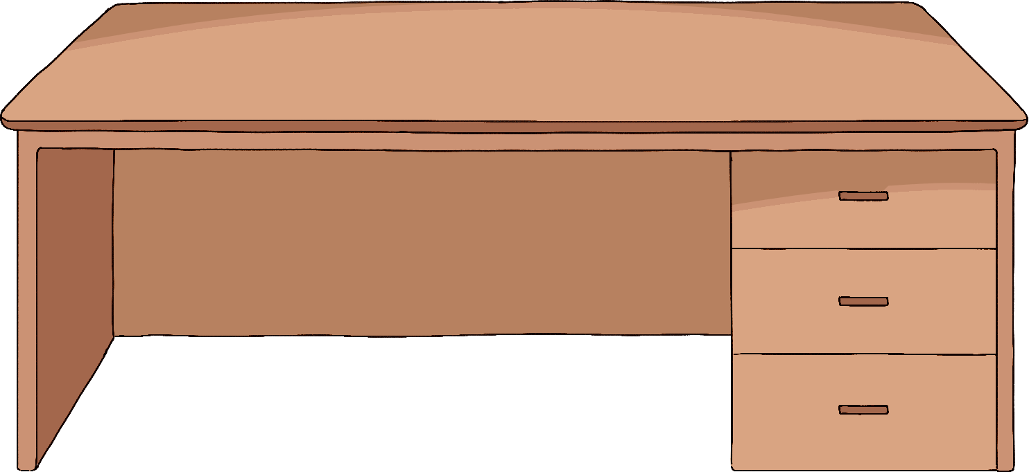
LITERATURE ROUND-UP
Notes:
Joanna
Now that you know a little about us, Esther and Alex will give you the background on health literacy and collaboration. Esther?

Slide 9

THE VALUE OF HEALTH LITERACY
Sorensen et al (2012)
Brennan et al (2020)
Notes:
Esther

Slide 10


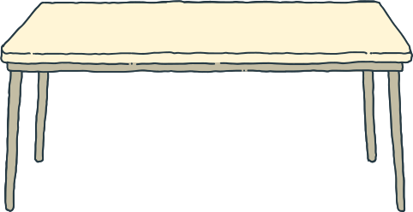
LITERACY LEVELS
STATISTICAL ATLAS
Literacy Levels in Adults
  Nationally
  Texas
  Arkansas
Notes:
Esther

Slide 11

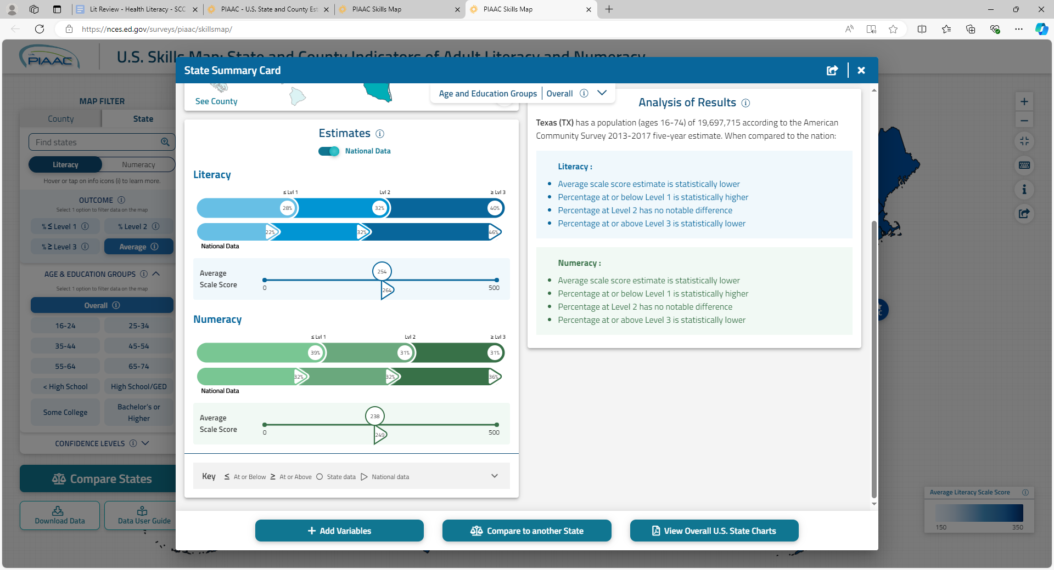
LITERACY LEVELS
TEXAS
  Average literacy score estimate is statistically lower than national average.
  Percentage at or below Level 1 is statistically higher.
National Center for Education Statistics, 2020.
Notes:
Esther

Slide 12

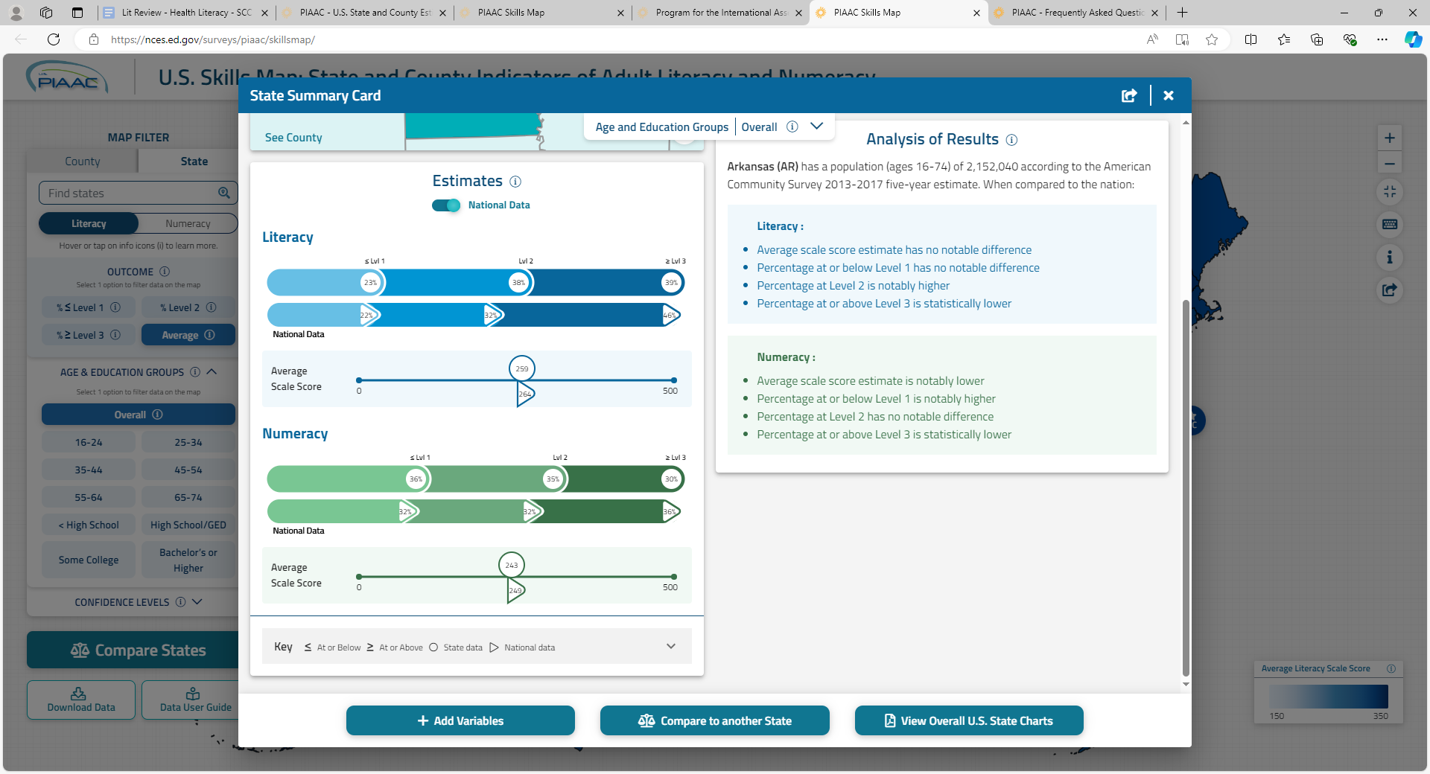
LITERACY LEVELS
ARKANSAS
  Average literacy score estimate is notably lower than national average.
  Percentage at or below Level 1 is notably higher.
National Center for Education Statistics, 2020.
Notes:
Esther

Slide 13
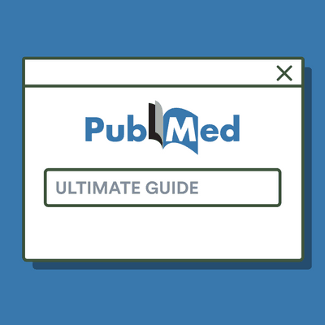
THE VALUE OF COLLABORATION
CURRENT HEALTH SCIENCE LITERATURE
Akers et al (2018)
Rios & Blake (2023)
Bradley et al (2010)
Notes:
Alex

Slide 14
KEY POINTS
COLLABORATIONS ARE THRIVING
  Health Science Professionals are collaborating within their institutions.
  Collaborations are essential.
  Collaboration projects focus less on the library and more on the teaching faculty.
Notes:
Alex

Slide 15

ACTIVITY
Collaborate with your table colleagues to implement a new health literacy project using the children’s literature provided.
  How might you use children’s literature to promote health & wellness at your institution?
  How could you collaborate with others on these projects?
Notes:
Esther

Slide 16

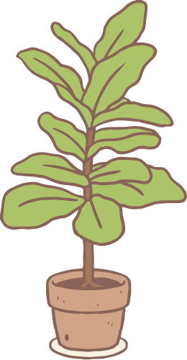
STEP ONE
10 MINUTES
REVIEW THE LITERATURE
Take some time on your own to go through the lists of children’s materials arranged by topic.
CONSIDER AND EXPLORE
Are the lists missing materials? How could you use these materials at your own institution?
Notes:
Esther

Slide 17
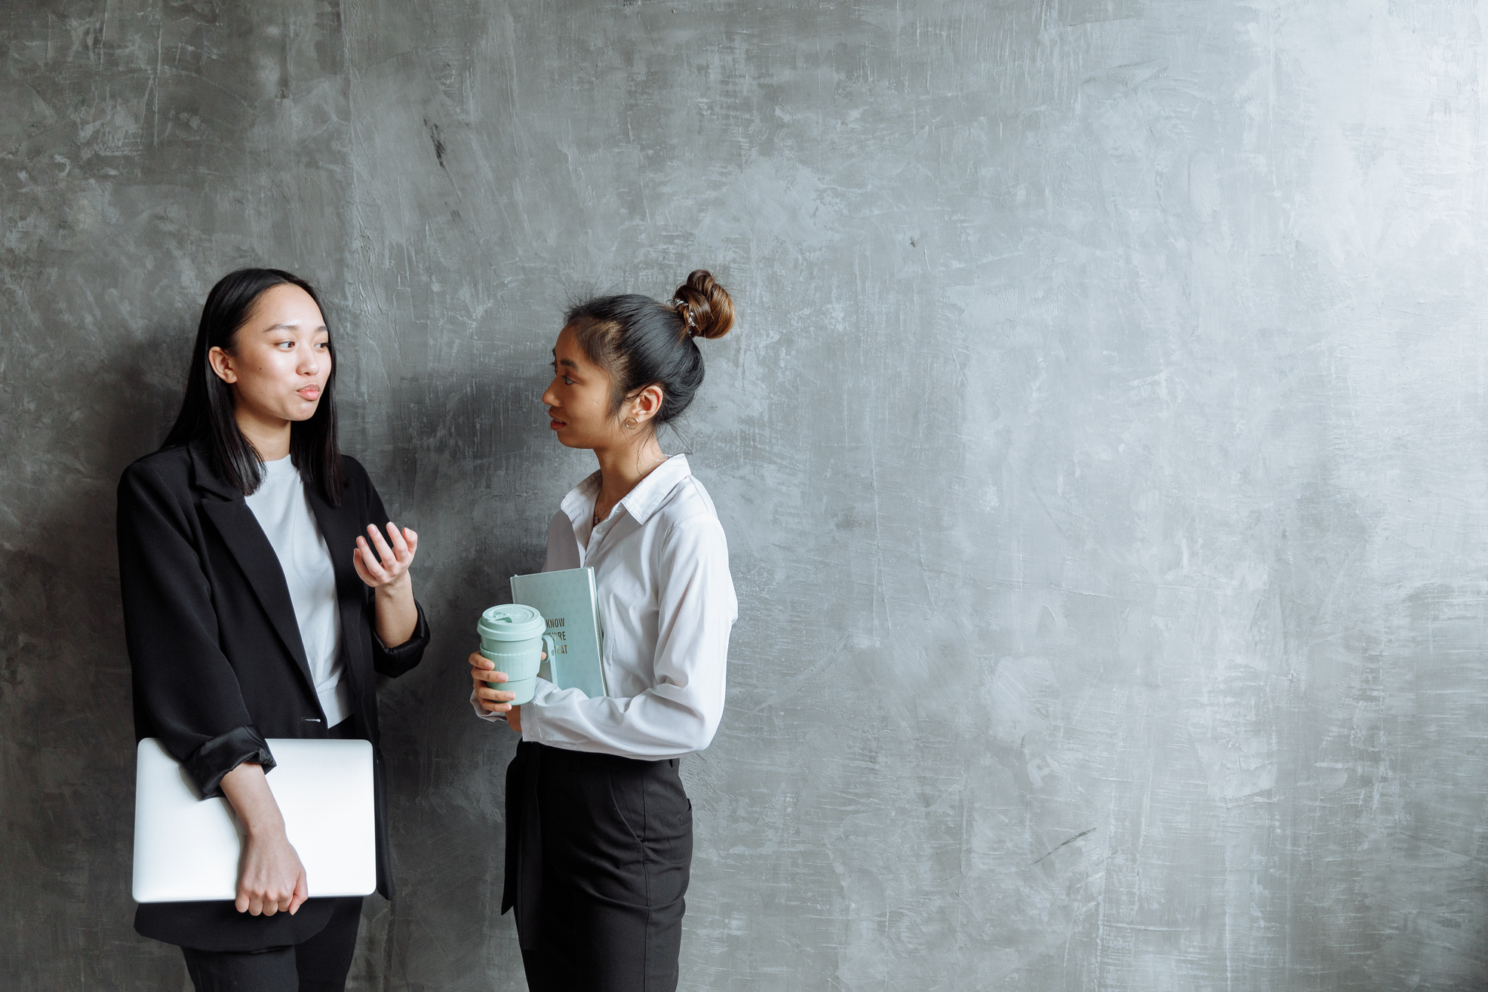
STEP TWO
8 MINUTES
DISCUSS YOUR IDEAS WITH A PARTNER
Develop an elevator speech to describe your project.
Notes:
Joanna
It's time to pair up. Talk to one person at your table about one of your ideas. Develop an elevator speech to describe that project -- a quick way to get people interested in 2 minutes or less.

Slide 18

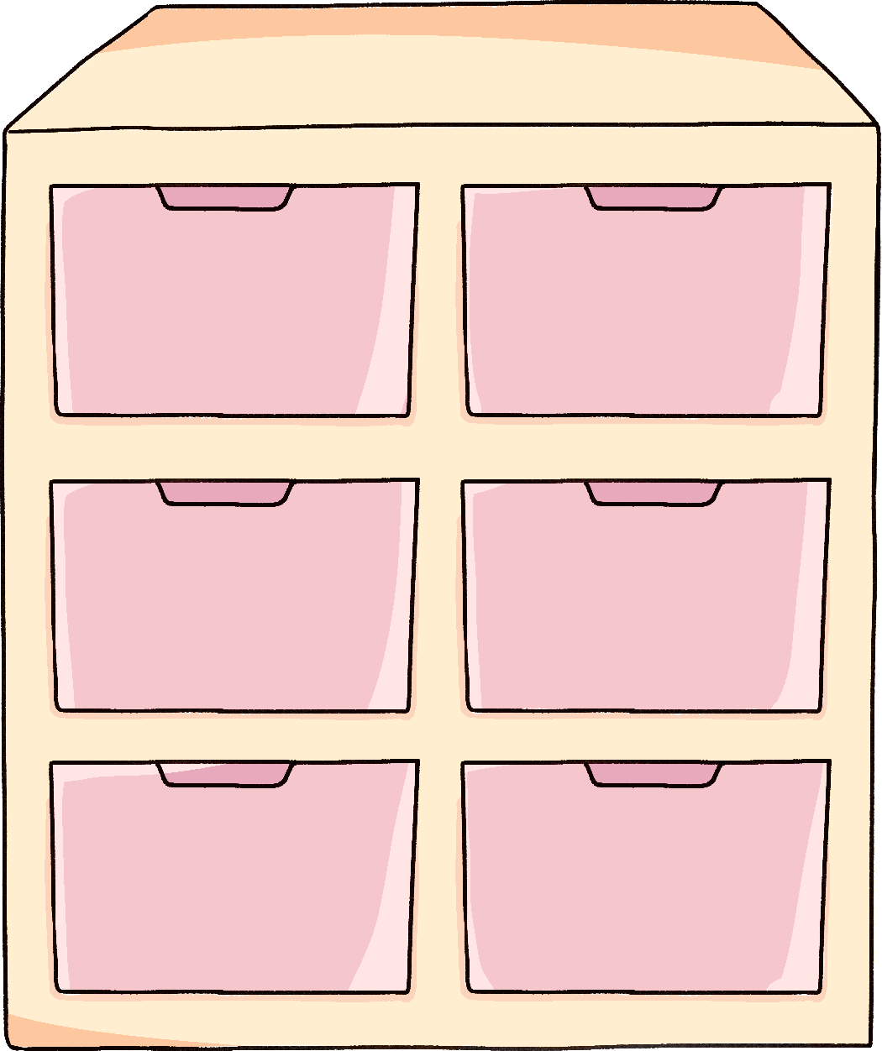
STEP THREE
12 MINUTES
DISCUSS YOUR IDEAS WITH YOUR TABLE
What could you do together that might be overwhelming to try alone?
Notes:
Alex

Slide 19
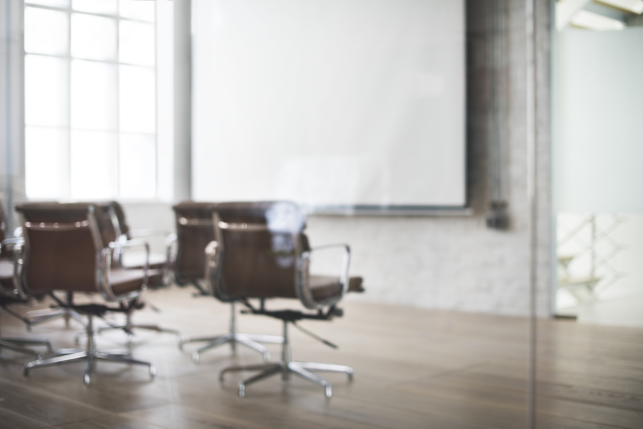
STEP FOUR
10 MINUTES
LET’S HEAR IT!
Share what you’ve created with the group.
Notes:
Esther

Slide 20


CONCLUSION
  As social beings, we all work better when we have others to brainstorm and collaborate with.
  There are many ways to build health literacy in your community.
  We hope you’re leaving with ideas for health literacy projects and collaborations.
Notes:
Alex

Slide 21
THANK YOU!
What questions or suggestions do you have for us?
Notes:
Joanna
Thank you so much for joining us here today. We'd love to hear from you -- what questions or suggestions do you have for us?

Slide 22

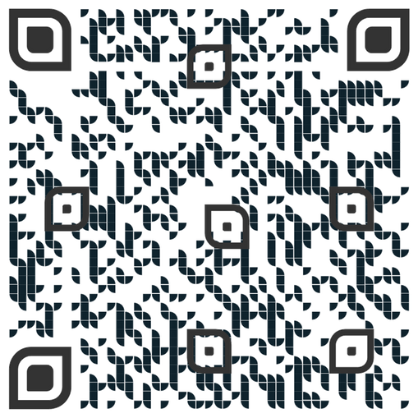
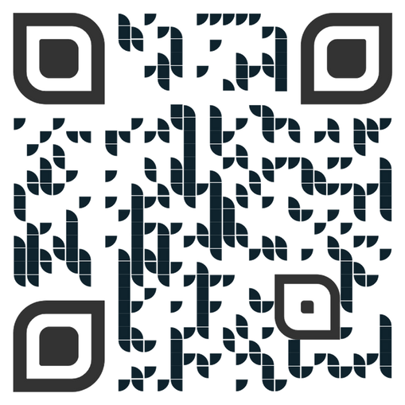
FEEDBACK
PLEASE FILL OUT OUR FEEDBACK FORM
VISIT OUR LIBGUIDE
FOR RESOURCES
Notes:
Joanna
You can ask them here today, or you can fill our the feedback form linked to by this QR code.
We also have a LibGuide on our presentation today, with links to our slides, the references from our literature reviews, Esther's own LibGuide on bibliotherapy, and more.

